Slide 1
Configuring Classification Management
Implementing File Management Tasks

Slide 2
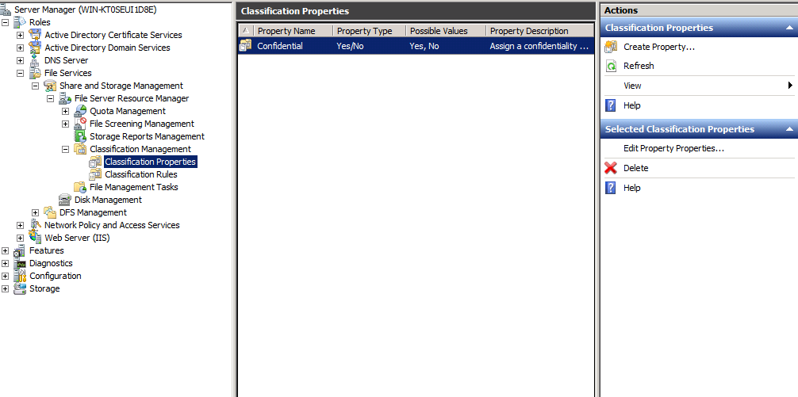
Right click on classification Properties and click Create Property, or click on Create Property under the Actions Menu

Slide 3
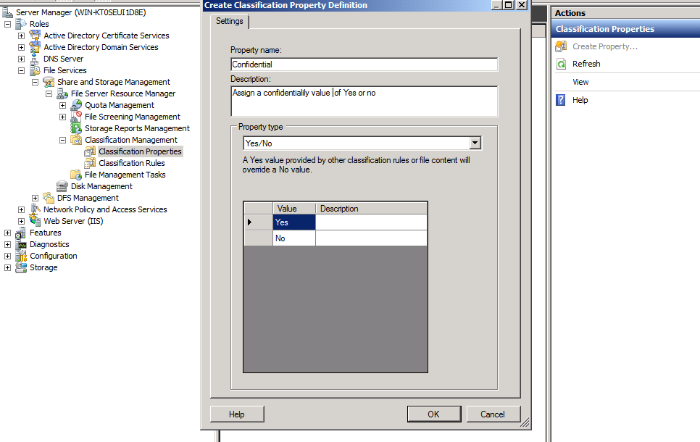
Type a property name and description, choose the value Yes/No, click OK

Slide 4
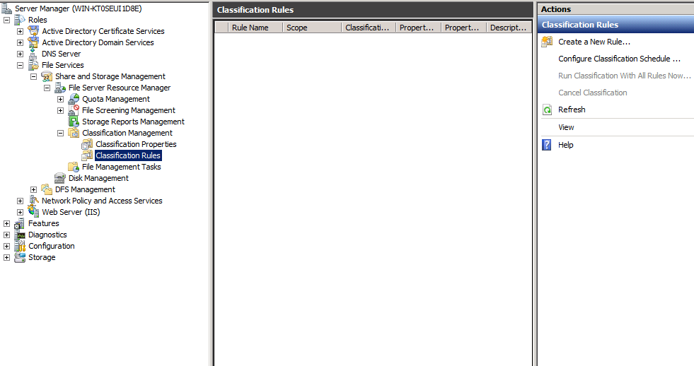
Select Classification Rules and click on Create a new rule

Slide 5
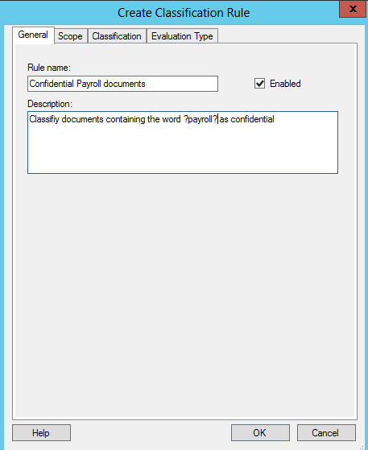
Type the rule name and description.

Slide 6
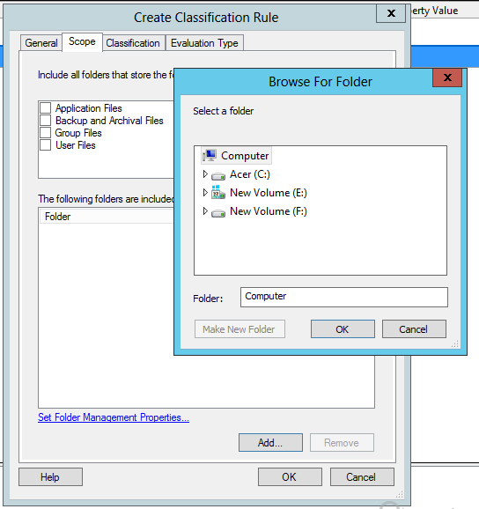
Click on scope, click Add and navigate to the data folder which contains the files and click ok

Slide 7
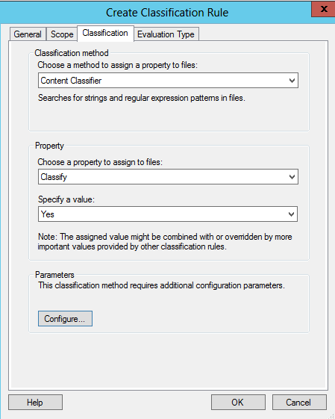
Choose a method, property name and value. In your case it would be Content classifier, your property name and property value.

Slide 8
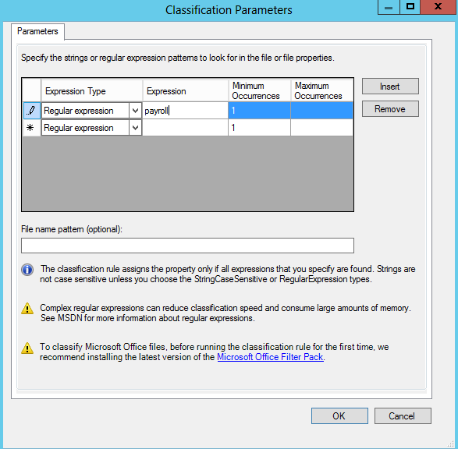
Click on Configure. Enter the expression payroll in the Expression column, then click on OK twice.

Slide 9
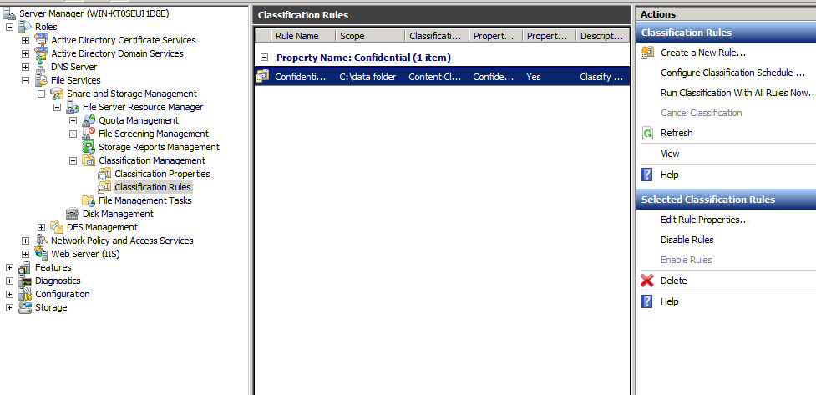
Select your classification rule and click on Run Classification with All Rules Now..

Slide 10
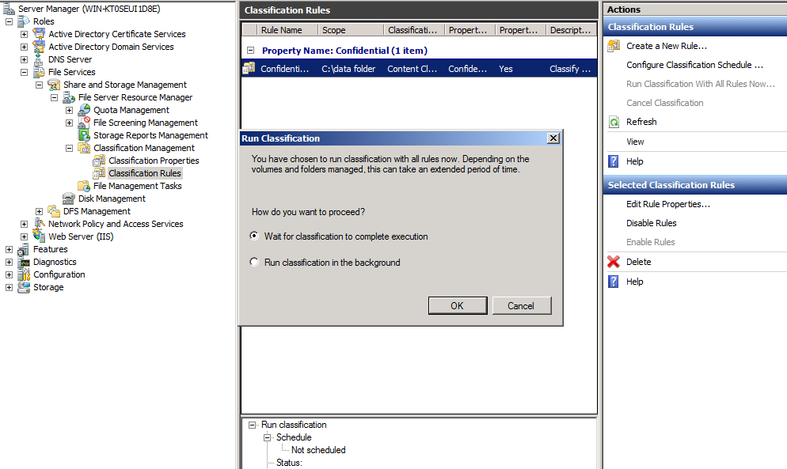
Select Wait for classification to complete execution an click on OK

Slide 11
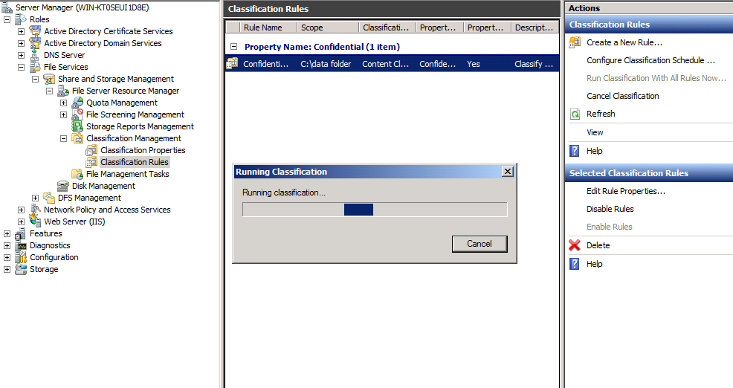
Classification is executing

Slide 12
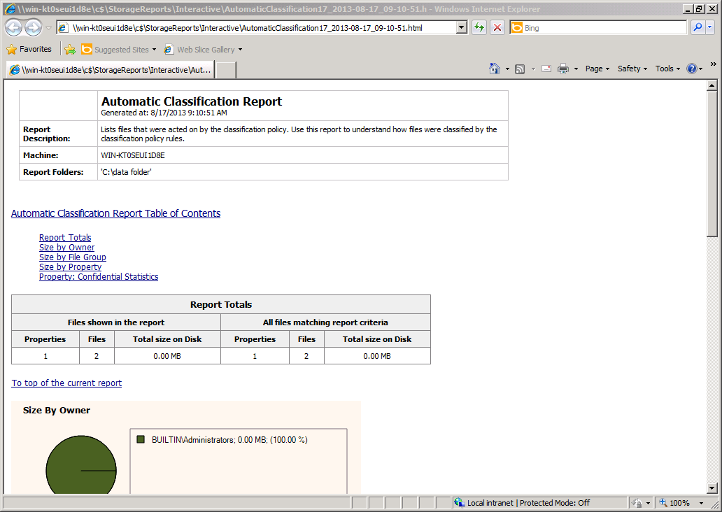

Slide 13
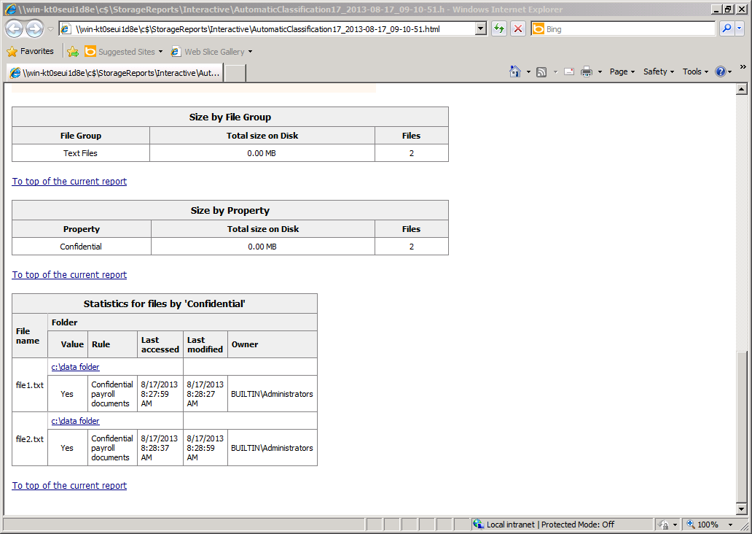

Slide 14
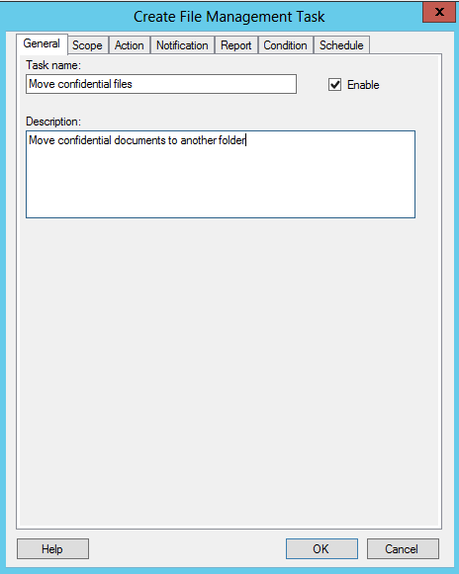
Select File Management Tasks, click on File Management tasks in the Actions Menu. Type the
Task name and description.

Slide 15
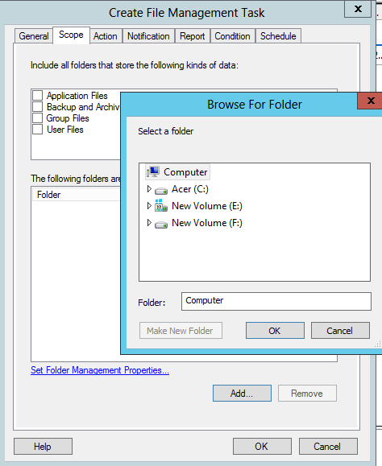
Select scope, click on Add and navigate to the folder that contain the files then click on OK.

Slide 16
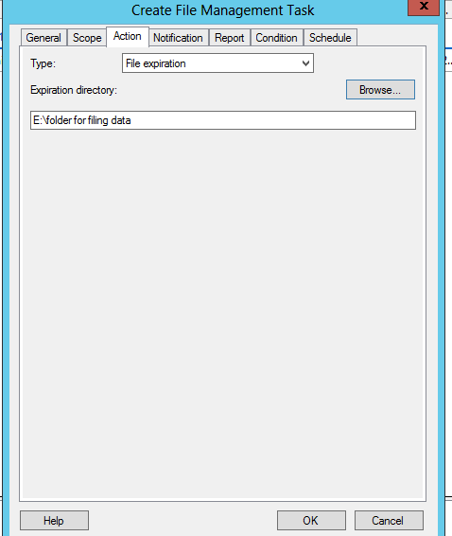
Next Select Action click on Browse and navigate to the folder into which you want the
Confidential files moved

Slide 17
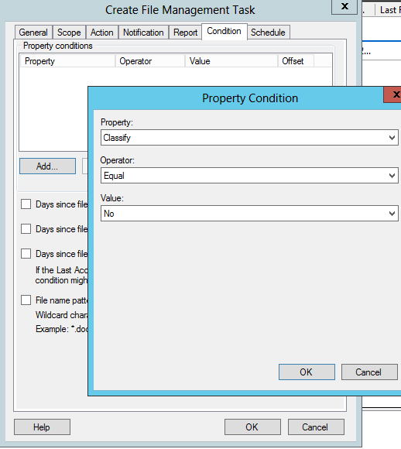
Next select condition and click Add. Select your property name, Operator and value, then click
on OK.

Slide 18
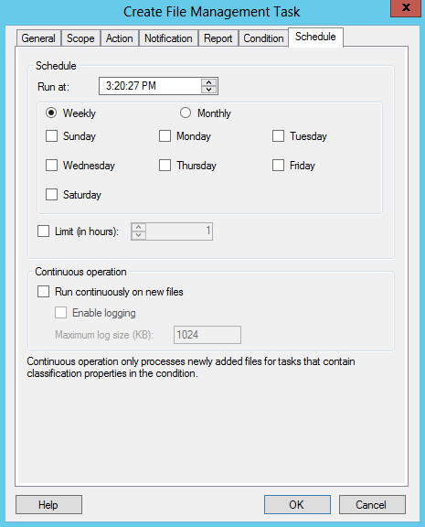
Click on schedule and select a day. Click on OK.

Slide 19
Select the task and click on Run File management task now

Slide 20
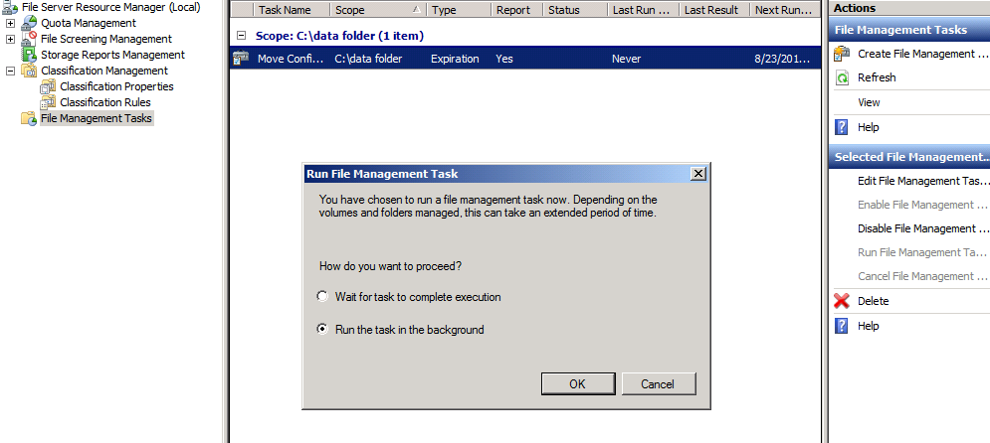
Select Wait for task to complete execution

Slide 21
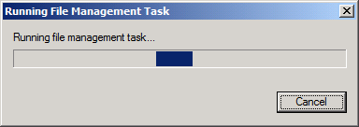
Task running

Slide 22
